Slide 1
Introduction to Web programming
0731213

Slide 2
Lecture 1 What is HTML?

Slide 3
What is HTML?
HTML is the standard markup language for creating Web pages.
HTML stands for Hyper Text Markup Language
HTML describes the structure of Web pages using markup
HTML elements are the building blocks of HTML pages
HTML elements are represented by tags
HTML tags label pieces of content such as "heading", "paragraph", "table", and so on
Browsers do not display the HTML tags, but use them to render the content of the page

Slide 4
A Simple HTML Document
<!DOCTYPE html>
<html>
<head>
<title>Page Title</title>
</head>
<body>
<h1>My First Heading</h1>
<p>My first paragraph.</p>
</body>
</html>

Slide 5
Example Explained
The <!DOCTYPE html> declaration defines this document to be HTML5
The <html> element is the root element of an HTML page
The <head> element contains meta information about the document
The <title> element specifies a title for the document
The <body> element contains the visible page content
The <h1> element defines a large heading
The <p> element defines a paragraph

Slide 6
HTML Tags
HTML tags are element names surrounded by angle brackets:
HTML tags normally come in pairs like <p> and </p>
The first tag in a pair is the start tag, the second tag is the end tag
The end tag is written like the start tag, but with a forward slash inserted before the tag name
Tip: The start tag is also called the opening tag, and the end tag the closing tag.
<tagname>content goes here...</tagname>

Slide 7
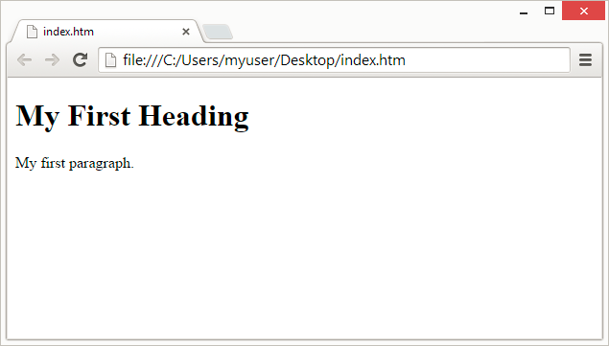
Web Browsers
The purpose of a web browser (Chrome, IE, Firefox, Safari) is to read HTML documents and display them.
The browser does not display the HTML tags, but uses them to determine how to display the document:

Slide 8
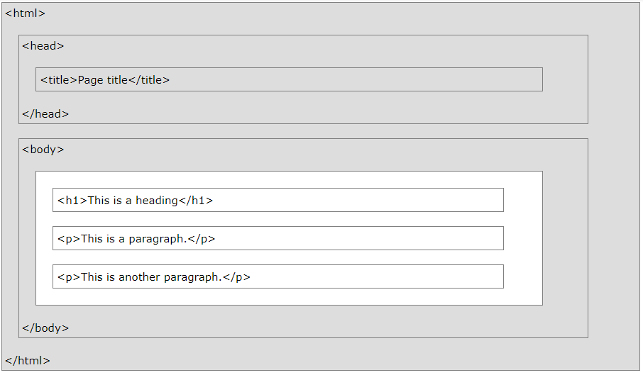
HTML Page Structure
Only the content inside the <body> section (the white area above) is displayed in a browser.

Slide 9
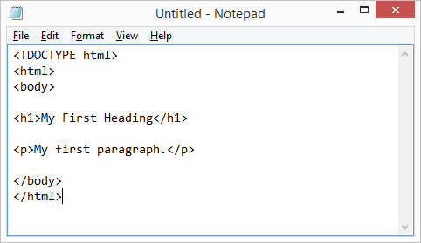
steps to create A web page
Follow the four steps below to create your first web page with Notepad/Notepad++ or TextEdit.
Step 1: Open Notepad/Notepad++ or TextEdit
Step 2: Write Some HTML into Notepad/Notepad++ or TextEdit

Slide 10
steps to create A web page
Follow the four steps below to create your first web page with Notepad/Notepad++ or TextEdit.
Step 3: Save the HTML Page

Slide 11
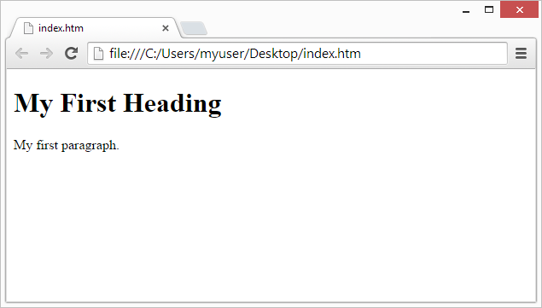
steps to create A web page
Follow the four steps below to create your first web page with Notepad or TextEdit.
Step 4: View the HTML Page in Your Browser

Slide 12
Lecture 2 HTML Tags (1)

Slide 13
HTML Documents
All HTML documents must start with a document type declaration: <!DOCTYPE html>.
The HTML document itself begins with <html> and ends with </html>.
The visible part of the HTML document is between <body> and </body>.
<!DOCTYPE html>
<html>
<body>
<h1>My First Heading</h1>
<p>My first paragraph.</p>
</body>
</html>

Slide 14
HTML Basic Tags
HTML Headings
HTML headings are defined with the <h1> to <h6> tags.
<h1> defines the most important heading. <h6> defines the least important heading.
<h1>This is heading 1</h1>
<h2>This is heading 2</h2>
<h3>This is heading 3</h3>
<h4>This is heading 4</h4>
<h5>This is heading 5</h5>
<h6>This is heading 6</h6>

Slide 15
HTML Basic Tags
HTML Paragraphs
HTML paragraphs are defined with the <p> tag.
<p>This is a paragraph.</p>
<p>This is another paragraph.</p>

Slide 16
HTML Basic Tags
HTML Line Break
HTML Line Break is defined with the <br/> tag
HTML elements with no content are called empty elements. Empty elements do not have an end tag such as the Line Break element
HTML Links
HTML links are defined with the <a> tag
The link's destination is specified in the href attribute.
Attributes are used to provide additional information about HTML elements.
<br/>
<a href="https://www.google.com">This is a link</a>
<a href="page1.html">This is a link</a>
<a href="pages/page1.html">This is a link</a>

Slide 17
HTML Basic Tags
HTML Images
HTML images are defined with the <img> tag.
The source file (src), alternative text (alt), width, and height are provided as attributes.
The alt attribute specifies an alternative text to be used, when an image cannot be displayed.
<img src="image.jpg" alt="This is an image" width="104" height="142">
<img src="images/image.jpg" alt="This is an image" width="104" height="142">

Slide 18
HTML Basic Tags
HTML button
HTML button defines a clickable button.
Inside a <button> element you can put content, like text or images. This is the difference between this element and buttons created with the <input> element.
Tip: Always specify the type attribute for a <button> element. Different browsers use different default types for the <button> element.
<button type="button">Click Me!</button>

Slide 19
HTML Basic Tags
HTML div
HTML div defines a division or a section in an HTML document.
The <div> tag is used to group block-elements to format them with CSS.
Tip: The <div> element is very often used together with CSS, to layout a web page.
Note: By default, browsers always place a line break before and after the <div> element. However, this can be changed with CSS.
<div id="myId">
<h3>This is a heading</h3>
<p>This is a paragraph.</p>
</div>

Slide 20
HTML Basic Tags
HTML span
HTML span is used to group inline-elements in a document.
The <span> tag provides no visual change by itself.
The <span> tag provides a way to add a hook to a part of a text or a part of a document.
Tip: When a text is hooked in a <span> element, you can style it with CSS, or manipulate it with JavaScript.
<p>My mother has <span style="color:blue">blue</span> eyes.</p>

Slide 21
Lecture 3 HTML Tags (2)

Slide 22
Nested HTML Elements
HTML elements can be nested (elements can contain elements).
All HTML documents consist of nested HTML elements.
<a href="https://www.google.com">
<img src="image.jpg" alt="google.com" width="104" height="142">
</a>

Slide 23
HTML Elements
Single or Double Quotes?
Double quotes around attribute values are the most common in HTML, but single quotes can also be used.
In some situations, when the attribute value itself contains double quotes, it is necessary to use single quotes:
<a href="page1.html">This is a link</a>
<a href='page1.html'>This is a link</a>

Slide 24
The HTML <head> Element
The <head> element is a container for metadata. HTML metadata is data about the HTML document. Metadata is not displayed.
The <head> element is placed between the <html> tag and the <body> tag
Metadata typically define the document title, character set, styles, links, scripts, and other meta information.
The <meta> tag defines metadata about an HTML document. Metadata is data (information) about data. <meta> tags always go inside the <head> element
<!DOCTYPE html>
<html>
<head>
<title>My First HTML</title>
<meta charset="UTF-8" />
</head>
<body>
.
.
.

Slide 25
HTML Comment Tags
You can add comments to your HTML source by using the following syntax
Notice that there is an exclamation point (!) in the opening tag, but not in the closing tag.
Comments are not displayed by the browser, but they can help document your HTML source code.
<!-- Write your comments here -->
<!-- This is a comment -->
<p>This is a paragraph.</p>
<!-- Remember to add more information here -->
<!--This is a comment. Comments are not displayed in the browser-->

Slide 26
Lecture 4 HTML Form (1)

Slide 27
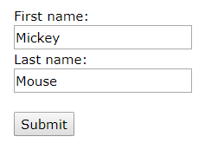
HTML Form Example
<form action="action_page.php">
First name:<br>
<input type="text" name="firstname" value="Mickey">
<br>
Last name:<br>
<input type="text" name="lastname" value="Mouse">
<br><br>
<input type="submit" value="Submit">
</form>

Slide 28
The <form> Element
The HTML <form> element defines a form that is used to collect user input
An HTML form contains form elements.
Form elements are different types of input elements, like text fields, checkboxes, radio buttons, submit buttons, and more.
<form> . form elements . </form>

Slide 29
The <input> Element
The <input> element is the most important form element.
The <input> element can be displayed in several ways, depending on the type attribute.
Type | Description
<input type="text"> | Defines a one-line text input field
<input type="radio"> | Defines a radio button (for selecting one of many choices)
<input type="submit"> | Defines a submit button (for submitting the form)

Slide 30
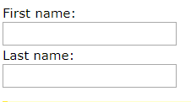
Text Input
<input type="text"> defines a one-line input field for text input
Note: The form itself is not visible. Also note that the default width of a text field is 20 characters.
<form>
First name:<br>
<input type="text" name="firstname" value="Mickey"><br>
Last name:<br>
<input type="text" name="lastname" value="Mouse">
</form>

Slide 31
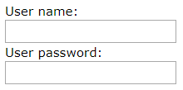
Password Input
<input type="password"> defines a password field
The characters in a password field are masked (shown as asterisks or circles).
<form>
User name:<br>
<input type="text" name="username"><br>
User password:<br>
<input type="password" name="psw">
</form>

Slide 32
Radio Button Input
<input type="radio"> defines a radio button.
Note: The form itself is not visible. Also note that the default width of a text field is 20 characters.
<form>
<input type="radio" name="gender" value="male" checked> Male<br>
<input type="radio" name="gender" value="female"> Female<br>
<input type="radio" name="gender" value="other"> Other
</form>

Slide 33
Checkbox Input
<input type="checkbox"> defines a checkbox.
Checkboxes let a user select ZERO or MORE options of a limited number of choices.
<form>
<input type="checkbox" name="vehicle1" value="Bike"> I have a bike<br>
<input type="checkbox" name="vehicle2" value="Car"> I have a car
</form>

Slide 34
The value Attribute
The value attribute specifies the initial value for an input field
<form action="">
First name:<br>
<input type="text" name="firstname" value="John">
</form>

Slide 35
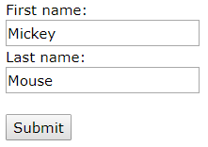
The Submit Button
<input type="submit"> defines a button for submitting the form data to a form-handler.
The form-handler is typically a server page with a script for processing input data.
The form-handler is specified in the form's action attribute
<form action="action_page.php">
First name:<br><input type="text" name="firstname" value="Mickey"><br>
Last name:<br><input type="text" name="lastname" value="Mouse"><br><br>
<input type="submit" value="Submit">
</form>

Slide 36
The <select> Element
The <select> element defines a drop-down list:
The <option> elements defines an option that can be selected.
By default, the first item in the drop-down list is selected.
To define a pre-selected option, add the selected attribute to the option:
<select name="cars">
<option value="volvo">Volvo</option>
<option value="saab">Saab</option>
<option value="fiat">Fiat</option>
<option value="audi">Audi</option>
</select>
<option value="fiat" selected>Fiat</option>

Slide 37
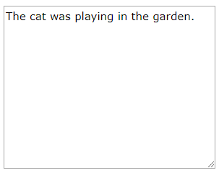
The <textarea> Element
The <textarea> element defines a multi-line input field (a text area)
The rows attribute specifies the visible number of lines in a text area.
The cols attribute specifies the visible width of a text area.
This is how the HTML code above will be displayed in a browser
<textarea name="message" rows="10" cols="30">
The cat was playing in the garden.
</textarea>

Slide 38
Lecture 5 HTML Form (2)

Slide 39
The Action Attribute
The action attribute defines the action to be performed when the form is submitted.
Normally, the form data is sent to a web page on the server when the user clicks on the submit button.
In the example above, the form data is sent to a page on the server called "action_page.php". This page contains a server-side script that handles the form data
If the action attribute is omitted, the action is set to the current page.
<form action="action_page.php">

Slide 40
The Method Attribute
The method attribute specifies the HTTP method (GET or POST) to be used when submitting the form data
<form action="action_page.php" method="get">
<form action="action_page.php" method="post">

Slide 41
GET VS. POST
When to Use GET?
The default method when submitting form data is GET.
GET must NOT be used when sending sensitive information! GET is best suited for short, non-sensitive, amounts of data, because it has size limitations too
However, when GET is used, the submitted form data will be visible in the page address field
When to Use POST?
Always use POST if the form data contains sensitive or personal information. The POST method does not display the submitted form data in the page address field.
POST has no size limitations, and can be used to send large amounts of data.
action_page.php?firstname=Mickey&lastname=Mouse

Slide 42
The Name Attribute
Each input field must have a name attribute to be submitted.
If the name attribute is omitted, the data of that input field will not be sent at all.
This example will only submit the "Last name" input field
<form action="action_page.php">
First name:<br>
<input type="text" value="Mickey"><br>
Last name:<br>
<input type="text" name="lastname" value="Mouse"><br><br>
<input type="submit" value="Submit">
</form>

Slide 43
Self Study
HTML Symbols (https://www.w3schools.com/html/html_symbols.asp)
HTML Charset (https://www.w3schools.com/html/html_charset.asp)
HTML Tables (https://www.w3schools.com/html/html_tables.asp)
HTML Lists (https://www.w3schools.com/html/html_lists.asp)
HTML5 New Elements (https://www.w3schools.com/html/html5_intro.asp)

Slide 44
References
https://www.w3schools.com/
Robin Nixon, Learning PHP, MySQL, JavaScript, and CSS, 2013
Mike McGrath, PHP & My SQL in easy steps, 2012.

Slide 45
The End

